Slide 1
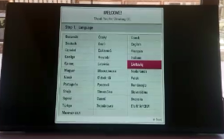
Service Bulletin
Bulletin Number:
General information
* Subject: [L15_M1A_FHD_EU_Models] Improved user setting initialization issue. (SW file)
* Bulletin Registration Date: 2016.07.28 | * Effective from Date: 2016.07.28 ~
Applicable for models
%LF5600-ZA, %LF5610-ZF, %LF561V-ZF, %LF570V-ZA
%LF560V-ZB, %LF562V-ZC, %LF563V-ZF, %LF564V-ZH
%LF620V-ZB, %LF560U-ZA, %LF560U-ZB, %LF562U-ZC
%LF564U-ZH, %LF563U-ZF, %LF5400-ZB, %LF540V-ZB
%LF560V-ZA, %LF560V-ZF, %LF550U-ZA, %LF551C-ZA
%LF550V-ZA, %LF620U-ZB, %LF510B-ZB, %LF510V-ZA
%LF510U-ZB, %LF5100-ZA
* Applicable Serial Number: All serial No.
Applicable in warranty: YES NO | Also applicable outside YES NO of warranty:
Applicable only with symptoms YES NO below: | Applicable with every repair: YES NO
Technical information
* 1) Symptoms / Customer Complaint - After power off/on, displayed first use. (It occurred when used for a long time/ Average using time : 15months) - After DC off/on, It can’t save volume&channel last memory. (It occurred when you turn off within 5 seconds after volume&channel change)
[Symptoms ]
* 2) Problem / Cause
- It is performed 8times to Nand read retry. So, It was modified to operate normally.
* 3) Solution: (Short explanation of the solution) To solve problem, please usb update to V03.08.01 A little bit caution is required during download like below. 1) Download below file. “m1a_official-build-lowend-m1a-aliante-eu-30801_RevNobuilds-aliante-m1a-106_V03.08.01_usb_V2_SECURED.epk”
1/2

Slide 2
S/W Download Guide
Rework Guide
Rework | Step 1. File copy Copy the download file to the “LG_DTV” folder of the USB device ※ The TV system searches only the “LG_DTV” folder to find the download files. Step 2. USB Download Mode User (Automatic) Mode - General case. - Current TV version is lower than USB upgrade file. Expert (Engineering) Mode - For Engineering. - If there are only the same or lower version files in the USB device you can’t use the user mode. But, you can use the expert mode.

Slide 3
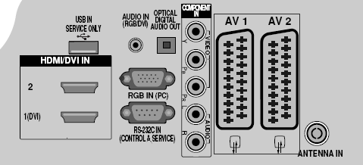
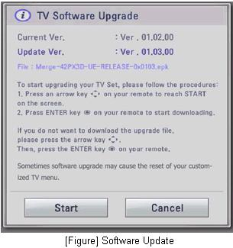
S/W Download Guide
Rework Guide
Rework | Step 3. USB Download – User (Automatic) Mode(1) Insert the USB device into the USB port of the TV. If the TV finds the same model name and new version file, it will display this message and start the upgrade automatically.
USB port

Slide 4
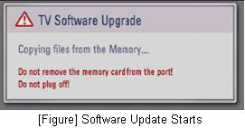
S/W Download Guide
Rework Guide
Rework | Step 3. USB Download – User (Automatic) Mode(2) Running USB Software Update Select [Start] button in “[Figure] Software Update” and press [OK] key. Then the USB Software Update starts as below. When below message is displayed, you must NOT remove the USB memory stick. When below message is displayed, do not unplug the TV power cord during upgrading. Copying the update file from the USB memory stick to the TV system memory. During updating, all inputs of remote control and local key are not operated.

Slide 5
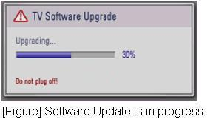
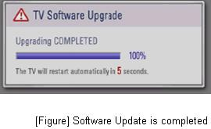
S/W Download Guide
Rework Guide
Rework | Step 3. USB Download – User (Automatic) Mode(3) The TV displays this progressive message to update new S/W to Flash memory. [User Mode] You may take away the USB memory stick from the TV. [Expert Mode] You can NOT take away the USB memory stick from the TV. If the upgrade is completed, this message is displayed. The TV will restart automatically in 5 seconds.

Slide 6
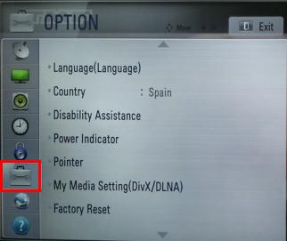
S/W Download Guide
Rework Guide
Rework | Step 4. USB Download – Expert (Engineering) Mode(1) Insert the USB device into the USB port of the TV. Press “FAV” key 7 times on the OPTION menu. Then, you will see the message of the next page.
USB port
Move the focus to the OPTION.
Press “FAV” key 7 times.

Slide 7
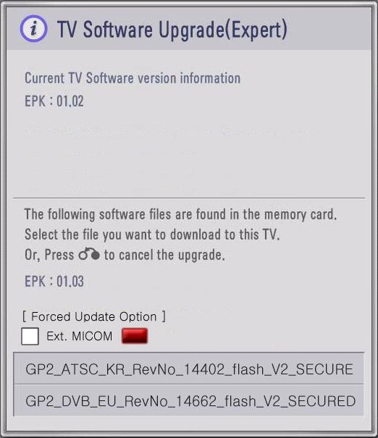
S/W Download Guide
Rework Guide
Rework | Step 4. USB Download – Expert (Engineering) Mode(2) Select the download file that you want to update. When you select the file, the TV displays the same message as User Mode(1). ※ The next process is the same as User Mode (2), (3).
[Forced Update Option]
Pressing red color key will update External MICOM
regardless of version.

